Slide 1
Concerned Citizens for Texas Water Resources
Austin and Waller Counties are faced with the particular problem of drilling and over pumping of the Evangeline Aquifer as per Electro Purification’s Application to transport groundwater to urban development areas that have crippled their own aquifers.
www.cctwr.org
Presenting here to Bluebonnet Groundwater Conservation District Directors and General Manager on May 20th 2013 at Bellville Fairgrounds for a Preliminary Hearing. We respectfully submit the herein contained facts, public comments and questions. Concerned Citizens for Texas Water Resources LPC respectfully asks to be considered as an affected party in all future presentments while not limiting any member from taking action as an individual party at any particular time.

Slide 2
Importance of the 1968 Texas Water Development study for Austin and Waller Counties. Is over use of our ground water resources about to be repeated again by Electro Purification?
Leonard V. Moore P. G.
1st Presenter

Slide 3
Can Austin and Waller County aquifers (Primarily the Evangeline) supply large volumes of fresh water to third parties? N0. At least not without causing damage to the primary Reservoirs

Slide 4
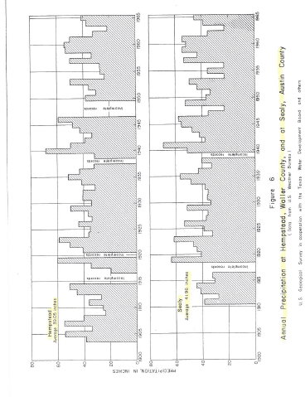
Over View of the impact of the proposed high rate extraction of reservoir waters from Austin and Waller Counties
Currently We have a self sustaining reservoir IF it is not over pumped

Slide 5
USGS used 113 wells. Evangeline Aquifer was the most heavily pumped reservoir Evangeline composed of a thick sequence of sands and clays which interfinger and pinch out over short distances Rainwater furnishes most of the recharge

Slide 6
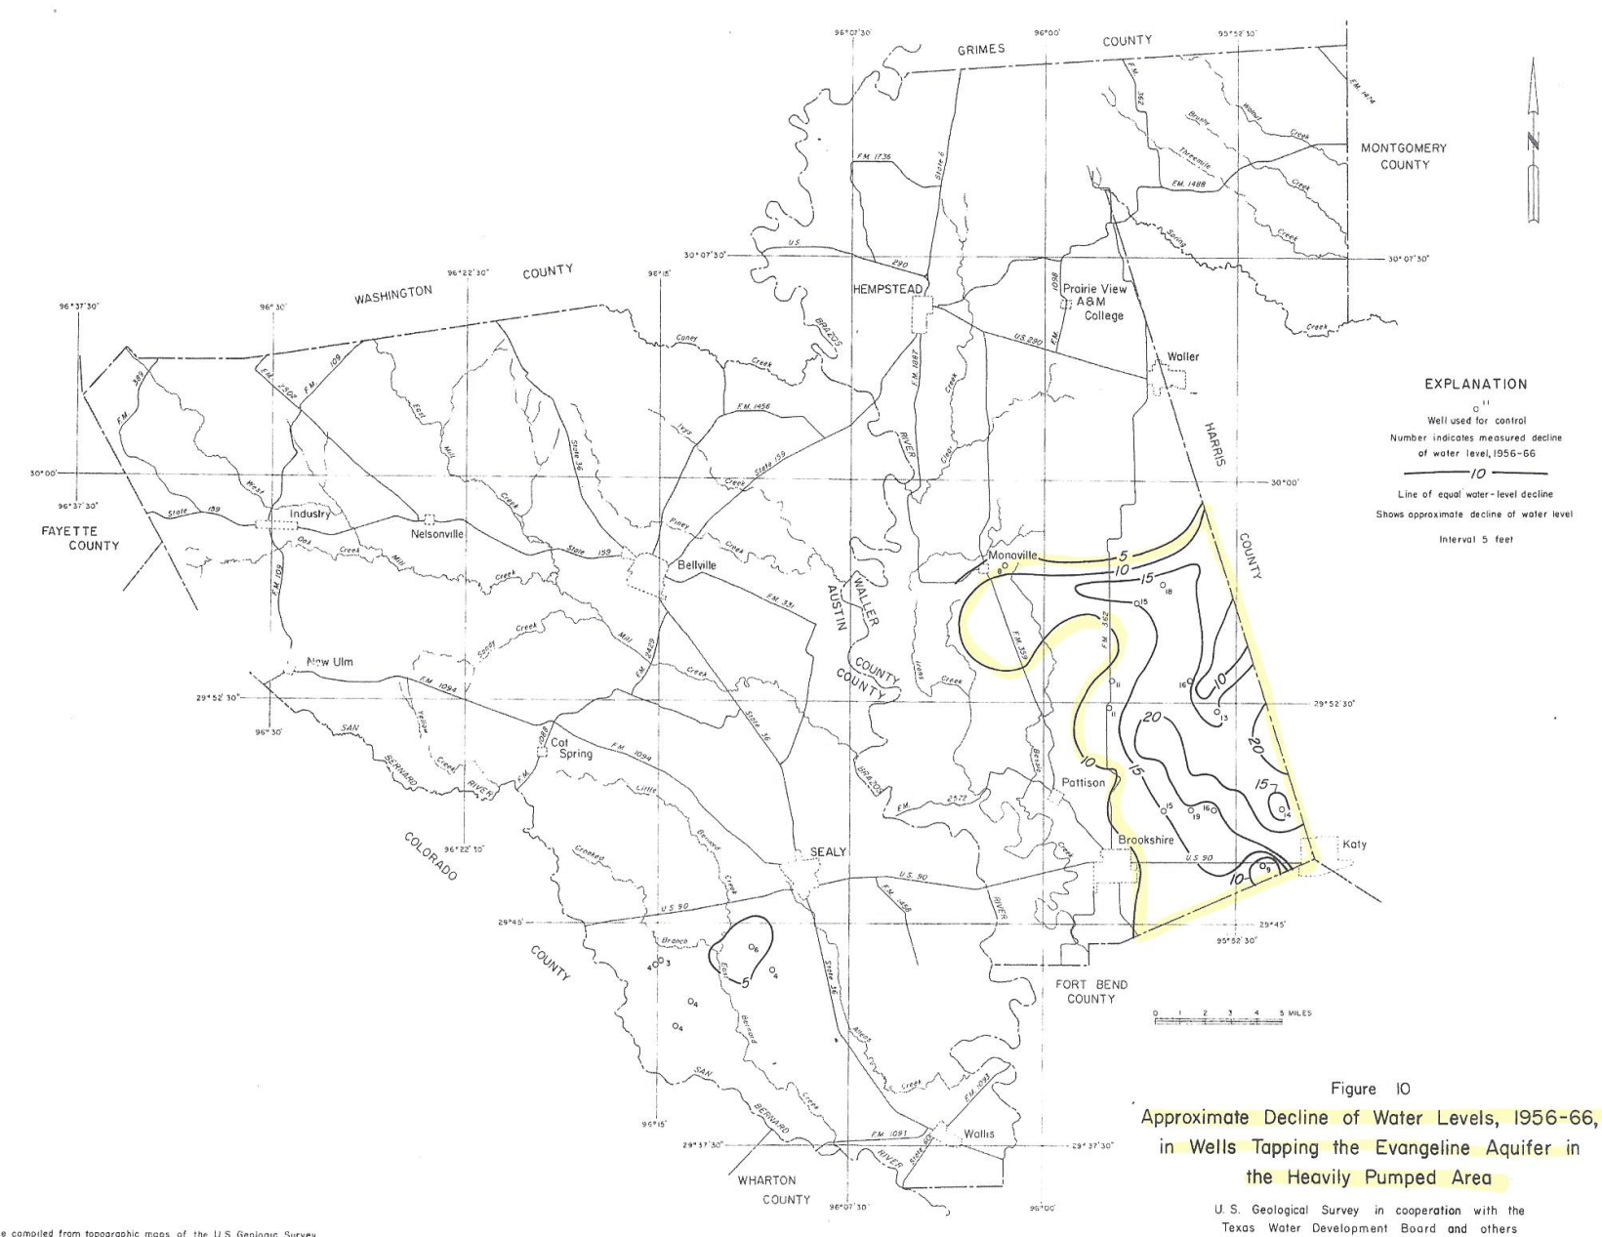
82-85% of this water was used for rice irrigation
Total pumpage of ground water in 1965 was 42million gallons per day in Waller County, and 8.9 million gallons per day in Austin County

Slide 7
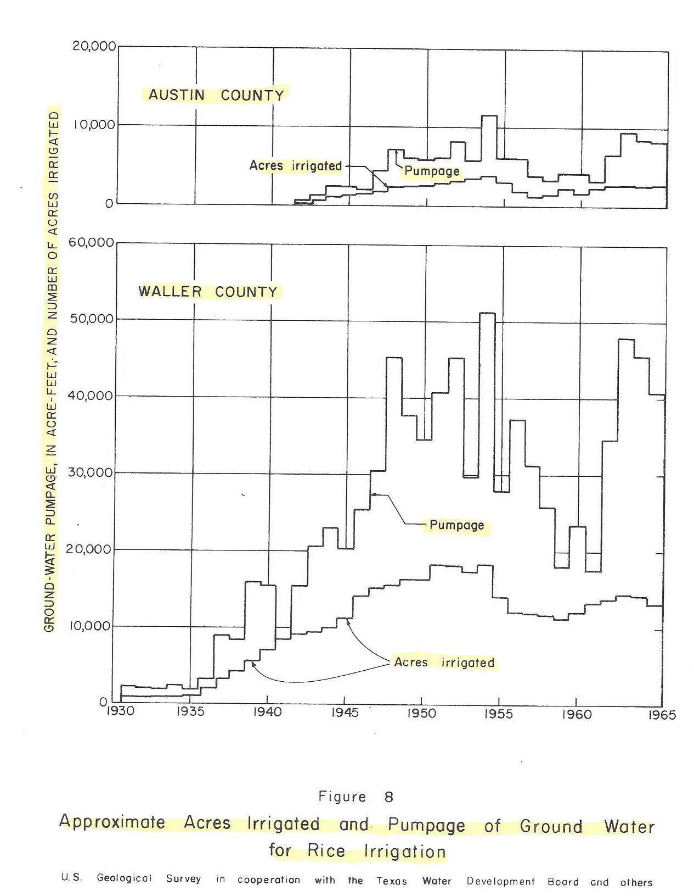
Historically Waller County was the largest producer. Water levels had fallen by 20 feet in 10 years in southern Waller county.
USGS study was likely undertaken to evaluate long-term viability of the these counties.

Slide 8
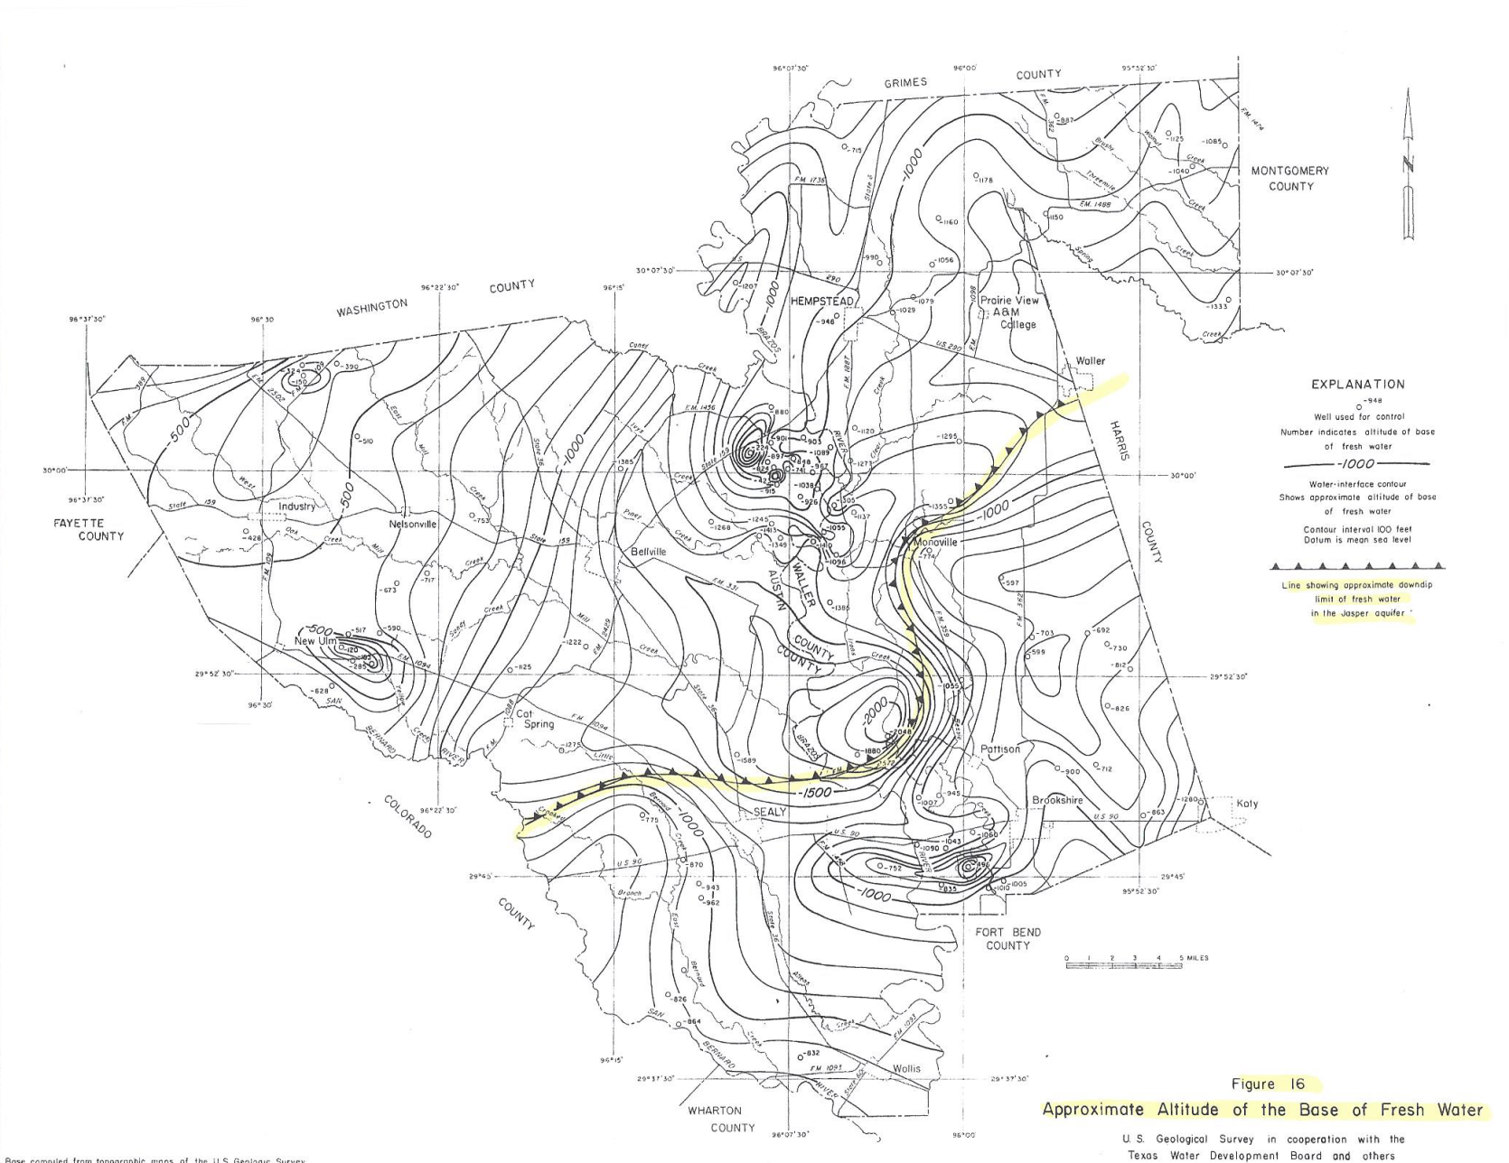
The deeper lying Jasper has been identified as a potential backup source of water. However there is a clear demarcation between fresh and saline water most likely caused by previous over pumping.

Slide 9
Main Points: 73 million acre feet are in the two counties. HOWEVER, only part of the water is available due to the poorer quality of lower, slightly saline aquifers. Evangeline has had damage caused by over pumping in the past, largely as a result of rice farming. Proposed new volumes, especially without the ‘rest’ periods provided by perennial water off takes, will lead to saline incursions and reservoir damage. Figure 24 Follows

Slide 10
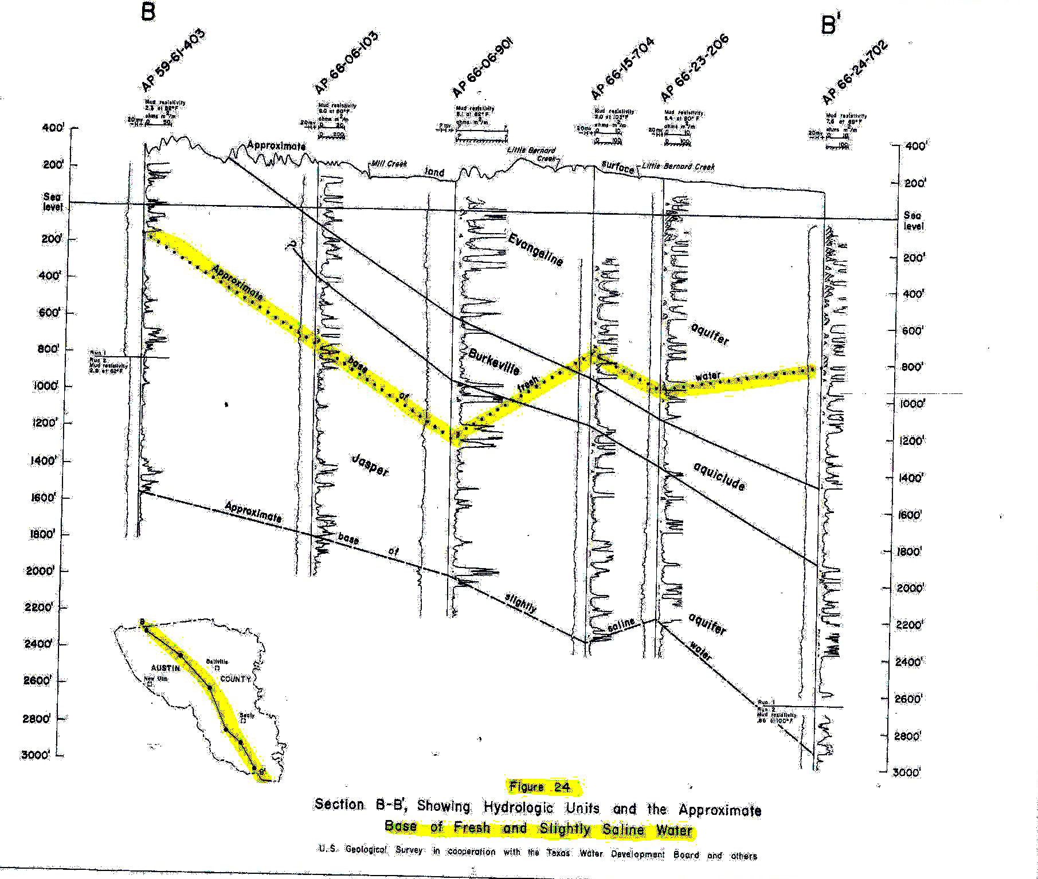

Slide 11
Leonard V. Moore Finishes Hubert Yoist Starts

Slide 12
Our Concerns are for the Citizens Hubert Yoist - Engineer
1. Electro Purification LLC filed an application for authorization for the completion of ten (10) new wells for production of groundwater with the Bluebonnet Groundwater Conversation District (BGCD). The wells will be a maximum of twenty-million gallons per day or approximately 22,500 acre-feet per annum. The produced water is to be used within the District and transported out-of-district transport to Fort Bend County, Texas. The metropolitan areas of Richmond-Rosenberg are to be the principle users of the water.
2. Total groundwater pumpage Sub-Area R/R (Richmond/Rosenberg) was 10.5mgd for 2011; a 41% increase from 2010.
3. Fort Bend County has experienced a 65% increase in population as of the 2010 census.
4. The four counties of the Bluebonnet Groundwater Conversation District (BGCD) averaged 18.75 % in population increase as of the 2010 census.
5. Electro Purification, Feb. 25, 2013: Wells will not significantly affect water levels in local wells. This Model – Used for well spacing and short-term drawdown

Slide 13
Nearest well deeper than 700 ft.
(6517417, TD = 740 feet)
Brookshire, Frydek, Simonton
Above from LP presentation of Feb.25 2013

Slide 14
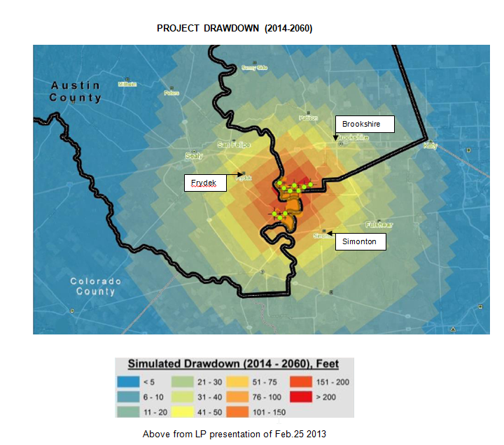

Slide 16
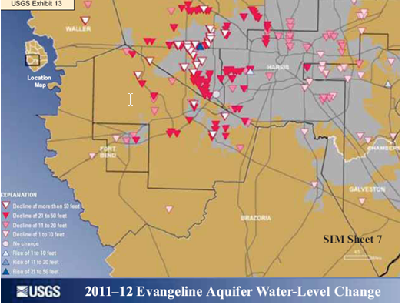

Slide 17
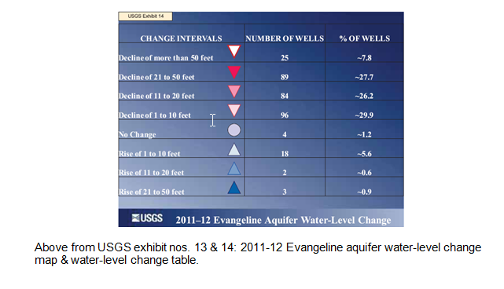

Slide 18
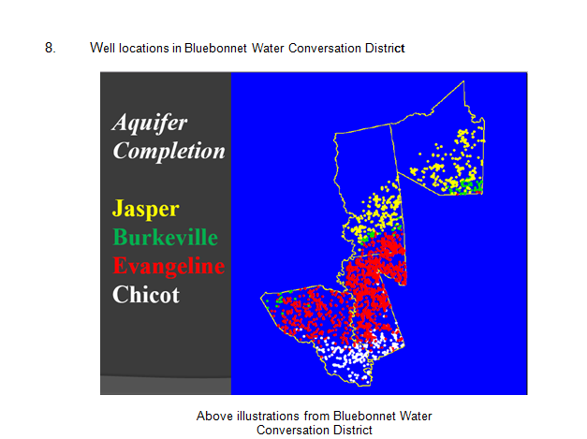

Slide 20
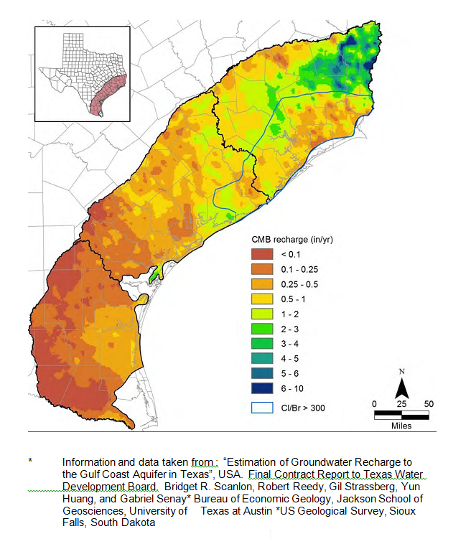

Slide 21
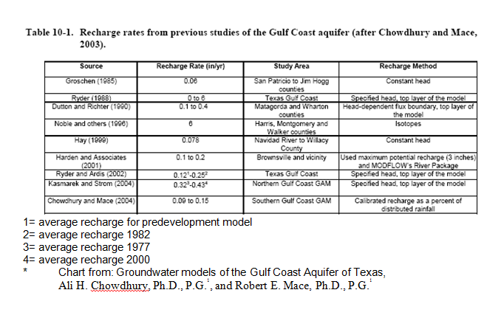

Slide 22
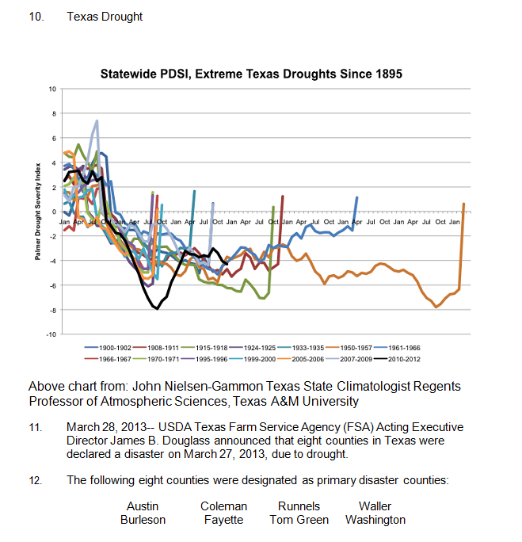

Slide 23
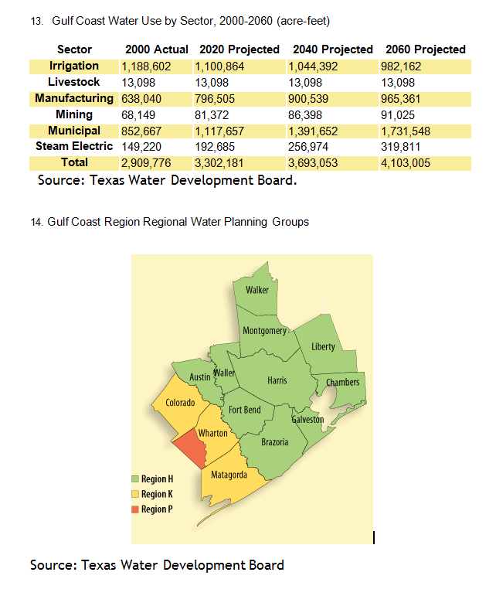

Slide 24
Hubert Yoist Finishes Tom Sherman Starts

Slide 25
Tom Sherman 3rd Presenter Geophysicist and Spokesperson for Concerned Citizens for Texas Water Resources

Slide 26
1. WHY IS EP APPLICAION WRONG
Study R68 Published in 1967 by USGS
Missing in Austin County
Missing in Waller County
Missing at Brazos River Authority
Missing at UT BEG
Found at TWDB (Certified & internet D/L
Ongoing study because differences found
Present Studies of R68 give every indication we…..
We are most likely to be worse off today than in 67/68.

Slide 27
2, WHY IS EP APPLICAION WRONG
Drilling of water wells in hazardous location
Known Salt Dome San Felipe/Brookshire)
Hydrogen Sulfide in other water wells.
Oil and/or Gas Operations in area
Subsurface character of dome not mapped
Base of salt and top of salt not mapped
2D and 3D geophysical data exist in area
7 of 10 wells are posted in WRONG locations

Slide 28
3 WHY IS EP APPLICAION WRONG
Notice of Demand (NOD) to BGCD re Rule 8.7B
Demand due to drought conditions
Conditions acclaimed and proclaimed
Drought not likely to subside experts say
Drought will increase production…
In Chico and Evangeline
Ergo drought does have an affect on….
All aquifers that are being used for production
The people must demand that Rule 8.7B be enforced.

Slide 29
4. WHY IS EP APPLICAION WRONG
Evangeline and deeper aquifers:
Not qualified or quantified.
Quality and inventory must be assessed
Science largely absent from info meetings.
Paper study not sufficient
Modeling subject to question.
Algorithm and input data……
Need to be audited and identified
Water inventory based on measurements?

Slide 30
5. WHY IS EP APPLICAION WRONG
Recent study of Computer modeling yielded:
1. When it comes to GAM’s and DFC’s…
It is what is available and is developing
2. Consider the distinct possibility that…..
Computer models produce:
GIGO (garbage in garbage out)
SWAG (Scientific Wild … Guess)
TBV (Trust But Verify) must be the minimum standard.
This slide produced by the same person that……..
produced the following slide.

Slide 31
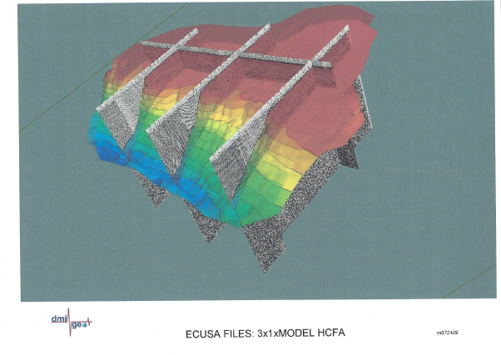

Slide 32
Issues To Be covered At Next Opportunity
Subsidence
Austin and Waller County Water Inventory
Austin and Waller County Production
Water Marketers
Developers
Other Stakeholders
Funding from State and/or Federal Govt.

Slide 33
We at CCTWR Wish to Thank The Concerned Citizens Bluebonnet Groundwater And Austin County For the opportunity to present and the sharing of your time.
Concerned Citizens for Texas Water Resources LPC
cctwr.org
713 444 5315
Contact us for updates of water issues across Texas

